Slide 1
Pointers
IIT, KUST

Slide 2
What are pointers for?
Accessing array elements
Passing arguments to a function when the function needs to modify the original argument
Passing arrays and strings to functions
Obtaining memory from the system
Creating data structures such as linked lists

Slide 3
Pointers and Programming Languages
Pointers are an important feature of C++ (and C), while many other languages, such as Visual Basic and Java, have no pointers at all.
Every byte in the computer’s memory has an address. Addresses are numbers, just as they are for houses on a street. The numbers start at 0 and go up from there—1, 2, 3, and so on.

Slide 4
Addresses and Pointers
Your program, when it is loaded into memory, occupies a certain range of these addresses.
That means that every variable and every function in your program starts at a particular address.

Slide 5
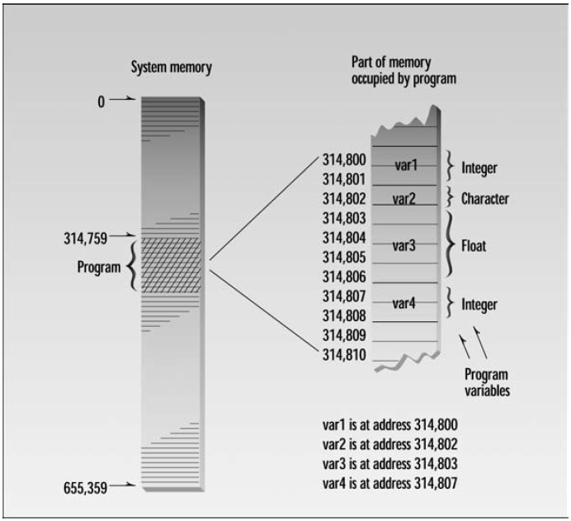

Slide 6
The Address-of Operator &
You can find the address occupied by a variable by using the address-of operator &.
// varaddr.cpp
// addresses of variables
#include <iostream>
using namespace std;
int main()
{
int var1 = 11; //define and initialize
int var2 = 22; //three variables
int var3 = 33;

Slide 7
The Address-of Operator &
cout << &var1 << endl //print the addresses
<< &var2 << endl //of these variables
<< &var3 << endl;
return 0;
}

Slide 8
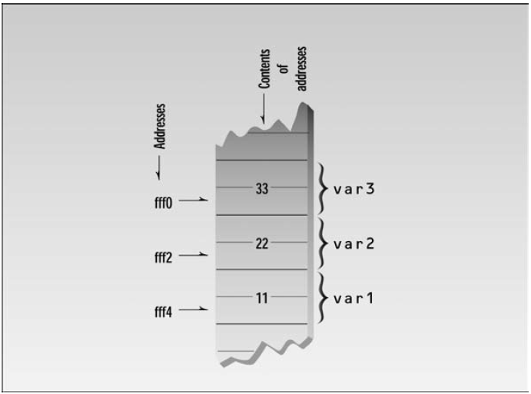

Slide 9
Pointer Variables
A variable that holds an address value is called a pointer variable, or simply a pointer.
// ptrvar.cpp
// pointers (address variables)
#include <iostream>
using namespace std;
int main()
{
int var1 = 11; //two integer variables
int var2 = 22;

Slide 10
Pointer Variables
cout << &var1 << endl //print addresses of variables
<< &var2 << endl << endl;
int* ptr; //pointer to integers
ptr = &var1; //pointer points to var1
cout << ptr << endl; //print pointer value
ptr = &var2; //pointer points to var2
cout << ptr << endl; //print pointer value
return 0;
}

Slide 11
The syntax used in C++ allows pointers to any type to be declared:
char* cptr; // pointer to char
int* iptr; // pointer to int
float* fptr; // pointer to float
Distance* distptr; // pointer to user-defined Distance class

Slide 12
char* ptr1, * ptr2, * ptr3; // three variables of type char*
Or you can use the asterisk-next-to-the-name approach.
char *ptr1, *ptr2, *ptr3; // three variables of type char*

Slide 13
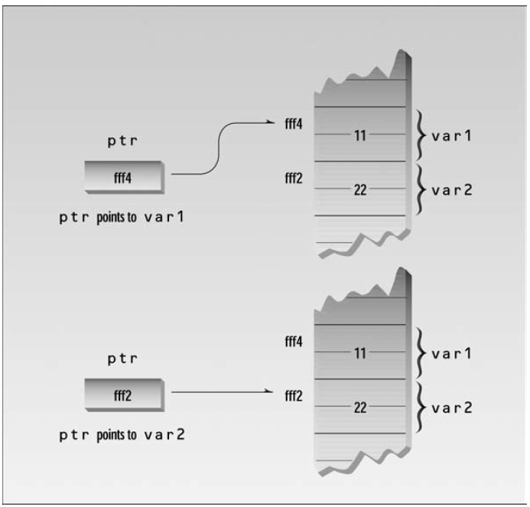
Pointers Must Have a Value
ptr = &var1; ←put address of var1 in ptr

Slide 14
Accessing the Variable Pointed To
// ptracc.cpp
// accessing the variable pointed to
#include <iostream>
using namespace std;
int main()
{
int var1 = 11; //two integer variables
int var2 = 22;

Slide 15
Accessing the Variable Pointed To
int* ptr; //pointer to integers
ptr = &var1; //pointer points to var1
cout << *ptr << endl; //print contents of pointer (11)
ptr = &var2; //pointer points to var2
cout << *ptr << endl; //print contents of pointer (22)
return 0;
}

Slide 16
You can use a pointer not only to display a variable’s value, but also to perform any operation you would perform on the variable directly.
// ptrto.cpp
// other access using pointers
#include <iostream>
using namespace std;
int main()
{
int var1, var2; //two integer variables
int* ptr; //pointer to integers
ptr = &var1; //set pointer to address of var1
*ptr = 37; //same as var1=37
var2 = *ptr; //same as var2=var1
cout << var2 << endl; //verify var2 is 37
return 0;
}

Slide 17
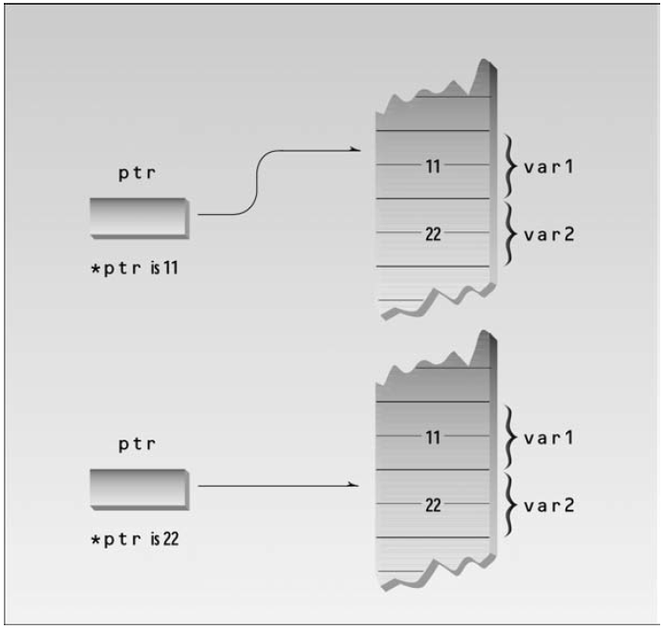

Slide 18
Here’s a capsule summary of what we’ve learned so far:
int v; //defines variable v of type int
int* p; //defines p as a pointer to int
p = &v; //assigns address of variable v to pointer p
v = 3; //assigns 3 to v
*p = 3; //also assigns 3 to v

Slide 19
Pointer to void
float flovar = 98.6;
int* ptrint = &flovar; //ERROR: can’t assign float* to int*
void* ptr; //ptr can point to any data type

Slide 20
Pointer to void
// ptrvoid.cpp
// pointers to type void
#include <iostream>
using namespace std;
int main()
{
int intvar; //integer variable
float flovar; //float variable
int* ptrint; //define pointer to int
float* ptrflo; //define pointer to float
void* ptrvoid; //define pointer to void
ptrint = &intvar; //ok, int* to int*
// ptrint = &flovar; //error, float* to int*
// ptrflo = &intvar; //error, int* to float*
ptrflo = &flovar; //ok, float* to float*

Slide 21
Pointer to void
ptrvoid = &intvar; //ok, int* to void*
ptrvoid = &flovar; //ok, float* to void*
return 0;
}

Slide 22
Pointers and Arrays
// arrnote.cpp
// array accessed with array notation
#include <iostream>
using namespace std;
int main()
{ //array
int intarray[5] = { 31, 54, 77, 52, 93 };
for(int j=0; j<5; j++) //for each element,
cout << intarray[j] << endl; //print value
return 0;
}

Slide 23
Pointers and Arrays
// ptrnote.cpp
// array accessed with pointer notation
#include <iostream>
using namespace std;
int main()
{ //array
int intarray[5] = { 31, 54, 77, 52, 93 };
for(int j=0; j<5; j++) //for each element,
cout << *(intarray+j) << endl; //print value
return 0;
}

Slide 24
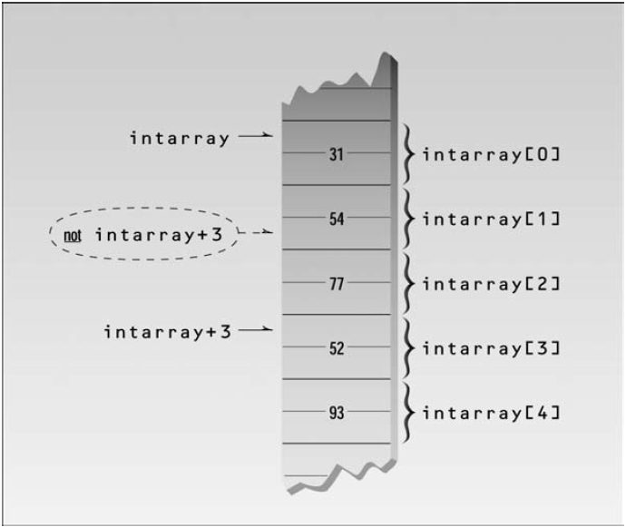

Slide 25
Pointer Constants and Pointer Variables
// ptrinc.cpp
// array accessed with pointer
#include <iostream>
using namespace std;
int main()
{
int intarray[] = { 31, 54, 77, 52, 93 }; //array
int* ptrint; //pointer to int
ptrint = intarray; //points to intarray
for(int j=0; j<5; j++) //for each element,
cout << *(ptrint++) << endl; //print value
return 0;
}

Slide 26
Pointers and Functions
Passing Simple Variables
// passref.cpp
// arguments passed by reference
#include <iostream>
using namespace std;
int main()
{

Slide 27
Pointers and Functions
void centimize(double&); //prototype
double var = 10.0; //var has value of 10 inches
cout << “var = “ << var << “ inches” << endl;
centimize(var); //change var to centimeters
cout << “var = “ << var << “ centimeters” << endl;
return 0;
}
//--------------------------------------------------------------
void centimize(double& v)
{
v *= 2.54; //v is the same as var
}

Slide 28
The next example, PASSPTR, shows an equivalent situation when pointers are used:
// passptr.cpp
// arguments passed by pointer
#include <iostream>
using namespace std;
int main()
{
void centimize(double*); //prototype
double var = 10.0; //var has value of 10 inches
cout << “var = “ << var << “ inches” << endl;
centimize(&var); //change var to centimeters
cout << “var = “ << var << “ centimeters” << endl;
return 0;
}
//--------------------------------------------------------------
void centimize(double* ptrd)

Slide 29
{
*ptrd *= 2.54; //*ptrd is the same as var
}

Slide 30
